Slide 1
بِسْمِ ٱللَّهِ ٱلرَّحْمَٰنِ ٱلرَّحِيمِ

Slide 2
Course: Web Designing
Institute: Corvit Systems Peshawar
Duration: 3-Month Web Designing & Development Course
2nd class of web designing
HTML Basic Tags & Writing Content

Slide 3
What we will learn today
By the end of this class, you will understand:
Setting up VS Code properly
Writing HTML paragraphs
Using line breaks <br/>
Adding comments in HTML
Formatting text (Bold, Italic, Underline)
Adding horizontal lines <hr>
Understanding the importance of semantics in HTML

Slide 4
VS Code Setup
Steps for installation:
Visit https://code.visualstudio.com/
Click on download for window button
After downloading click on install
Steps for writing code in VS Code
Open vscode
Create a folder in vscode
Create index.html file
Write your code and save file
Run index.html and enjoy coding
VS Code helps us write code faster with auto-suggestions, formatting, and extensions.

Slide 5
HTML Paragraph Tag <p>
The paragraph tag is used to write normal text.
Example :
<p>This is a paragraph of text.</p>
Characteristics:
Creates a block of text
Adds spacing automatically
Used for paragraphs, descriptions, and content sections
Every website uses paragraphs to present readable text.

Slide 6
Line Break Tag <br/>
<br> creates a new line without starting a new paragraph.
Example
<p>Hello Students!<br>Welcome to Web Designing Class.</p>
Use <br> when:
You want to break a line within the same paragraph
Writing poetry, addresses, or short lines
Important:
Do NOT use <br> for spacing

Slide 7
HTML Comments
Comments are used to write notes for yourself or other developers.
Syntax:
<!-- This is a comment -->
Features:
Not visible on the webpage
Used for reminders, explanations, disabling code temporarily
Helps keep your code clean and understandable
Explain:
Professional developers always use comments to maintain code quality.

Slide 8
Formatting Tags (Bold, Italic, Underline)
Bold Text → <b>
Highlights important words.
<b>This text is bold.</b>
Italic Text → <i>
Used for emphasis or special words.
<i>This text is italic.</i>
Underline Text → <u>
Used rarely for important names or terms.
<u>This text is underlined.</u>
Explain:
Later we will use CSS for formatting, but these tags help in basic styling.

Slide 9
Horizontal Line <hr>
The <hr> tag is used to visually separate sections.
Example:
<hr>
It is useful for:
Dividing topics
Creating section breaks
Making content easier to read
Explain:
<hr> adds a line but is not recommended for layout — CSS will replace this later.

Slide 10
Semantic Importance
Semantic HTML means using meaningful tags instead of generic ones.
Example:
( ❌ ) Using <div> for everything
( ✔️ ) Using <header> <nav> <section> <article> <footer>
Why semantics matter:
Improves SEO (Google understands your page better)
Helps screen readers (Accessibility)
Code becomes more organized
Makes you a professional developer
Explain to students:
Learning semantics early is the foundation of good web design.

Slide 11
Practical Example of All Tags
Below are the examples:
<!-- Class 2 Code Example -->
<p>Hello, this is my first paragraph.</p>
<b>This is bold text.</b>
<br>
<i>This is italic text.</i>
<br>
<u>This is underlined text.</u>
<hr>
<p>Learning HTML is fun and interesting!</p>

Slide 12
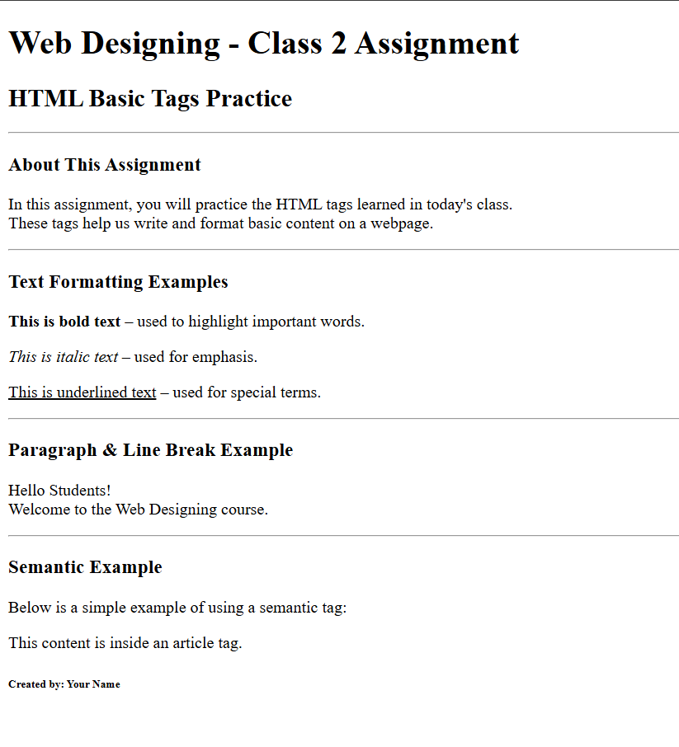
Assigment 2

Slide 13
Summary of today Class
Today we covered:
How to set up VS Code
Writing paragraphs with <p>
Using <br> for line breaks
Adding comments
Formatting text using <b>, <i>, <u>
Adding dividers with <hr>
Understanding why semantic HTML is important
Next Class → HTML Lists & Image Tags

